Slide 1


Slide 2
Framework

Slide 3
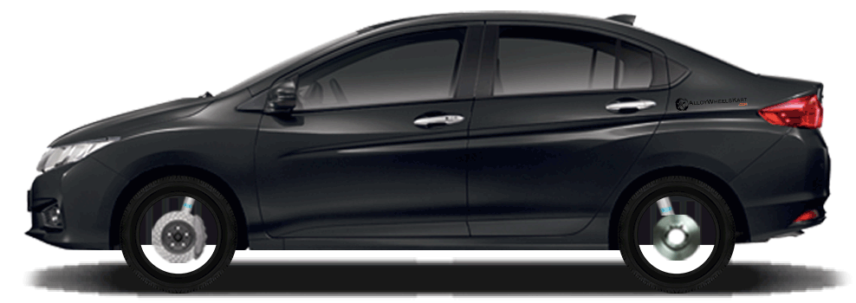
Framework ~~ Build a Car

Slide 4
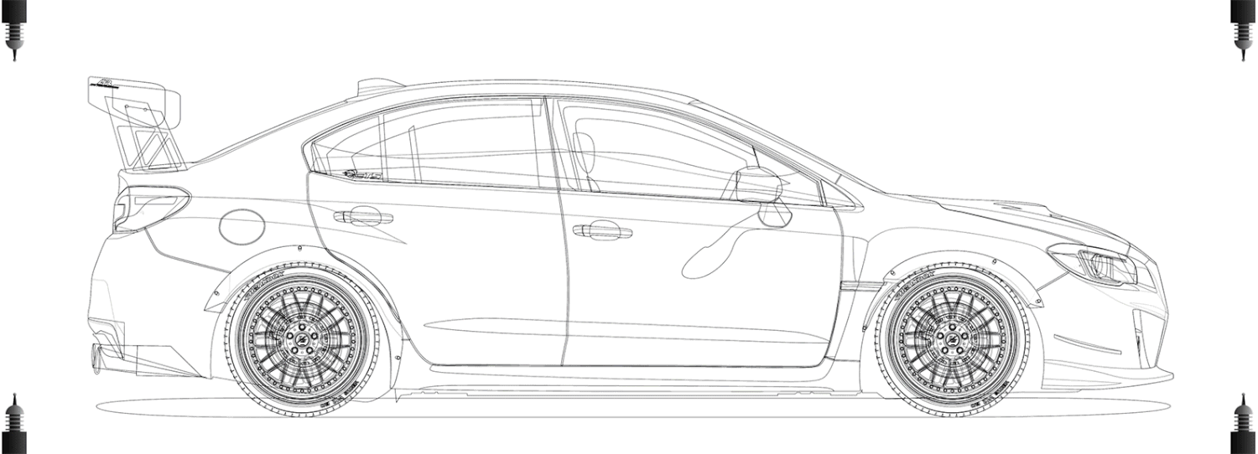

Slide 5
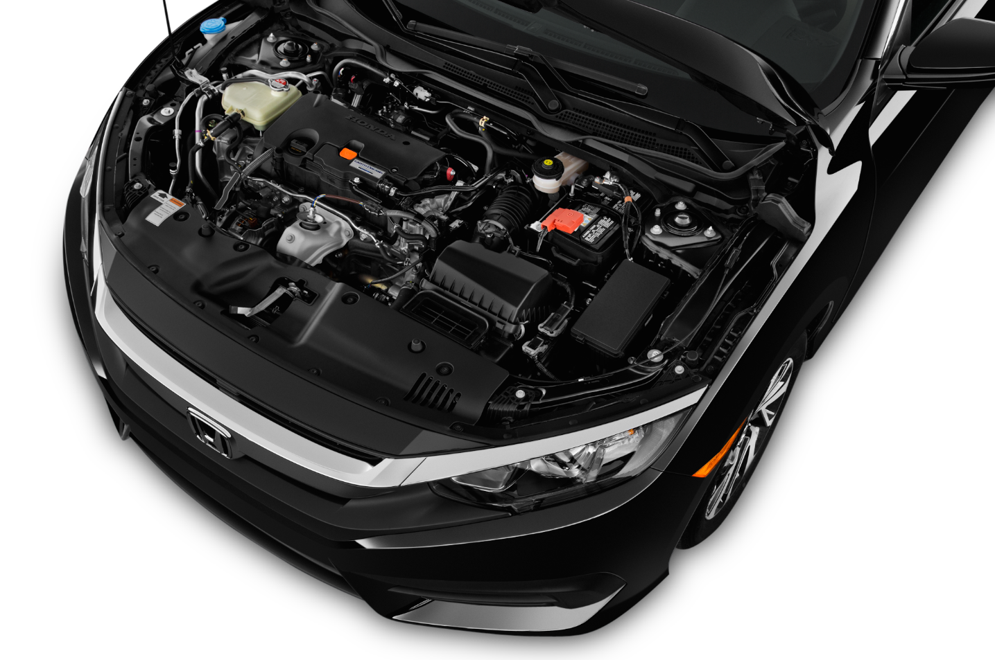
Engine = Wrappers (In Week 2 and 3)

Slide 6

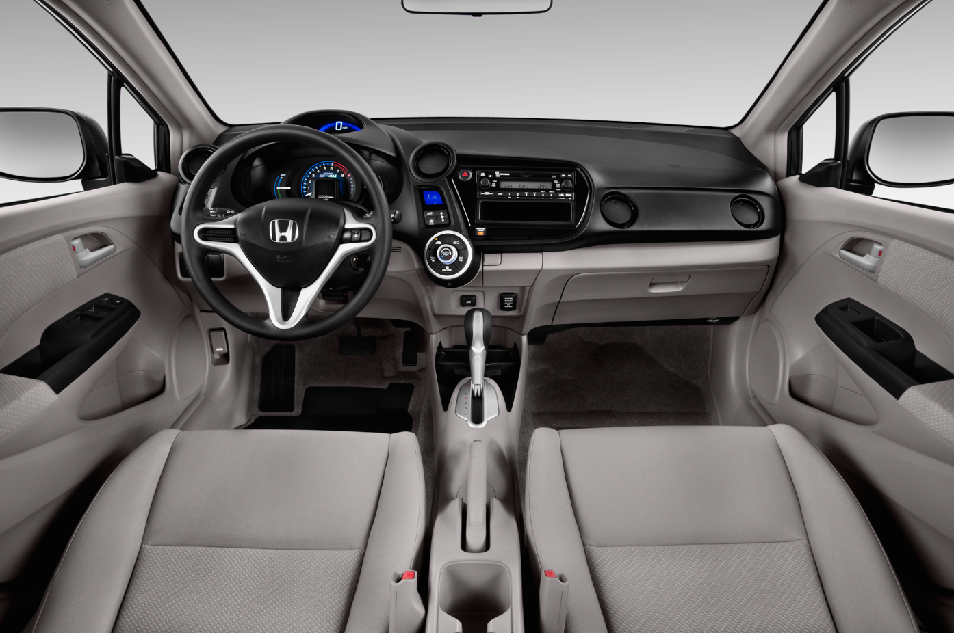
Run / Execution = TestNG

Slide 7

Petrol / Fuel = Excel Input / Apache POI

Slide 8
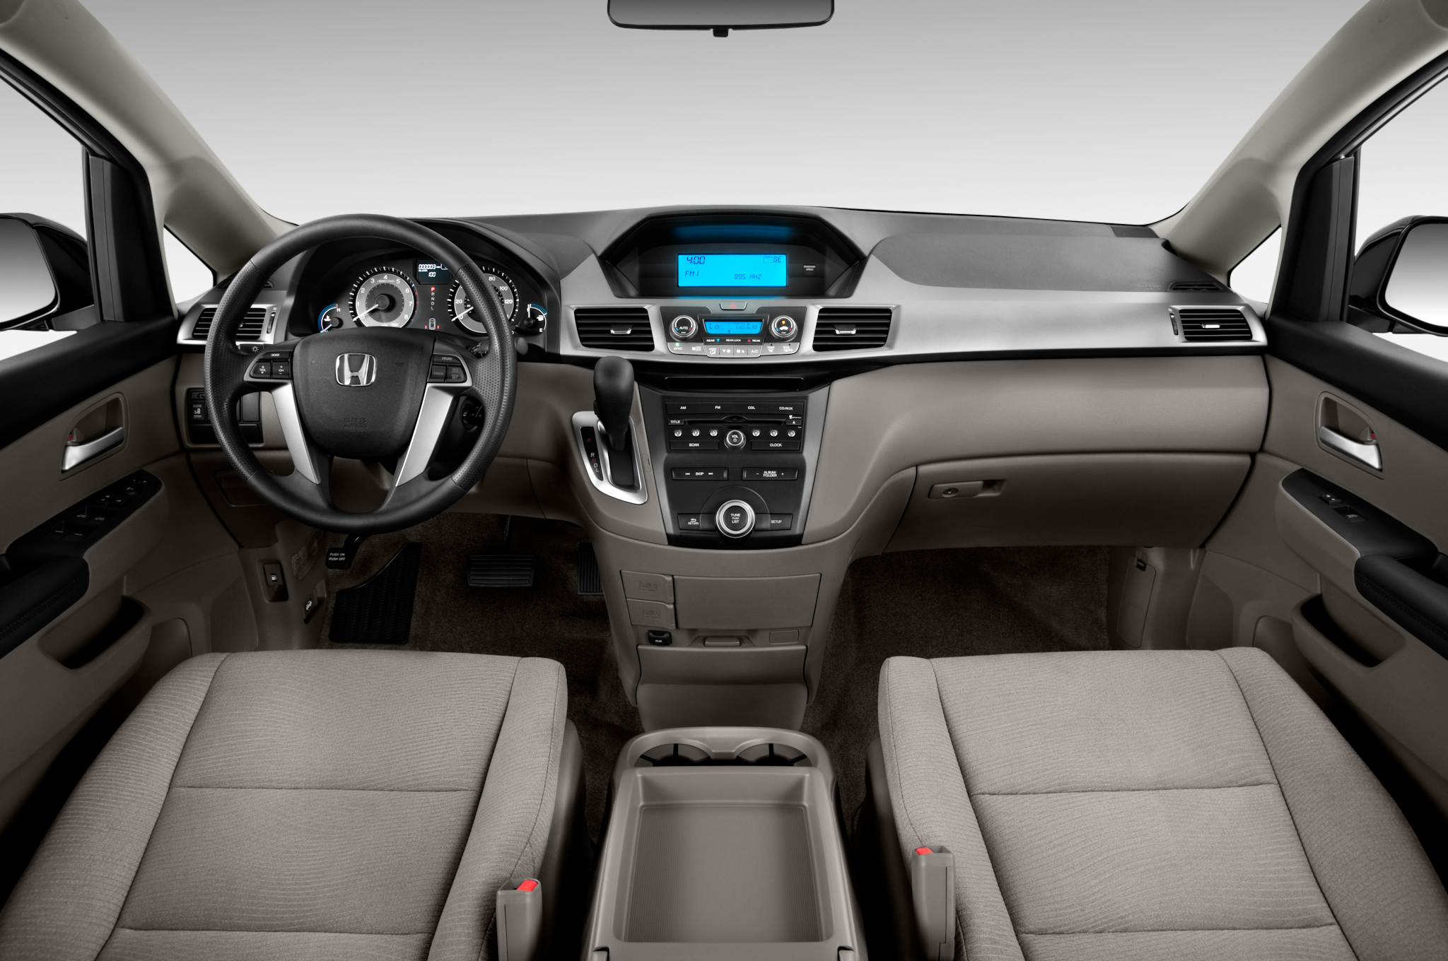
Dashboard = Report / Extent Reports

Slide 9


Slide 10



Slide 11

















What if the object locator Value changes?

Slide 12



















What if the locator itself changed?

Slide 13


What if you are testing for multiple languages?

Slide 14

So how to Solve these?

Slide 15
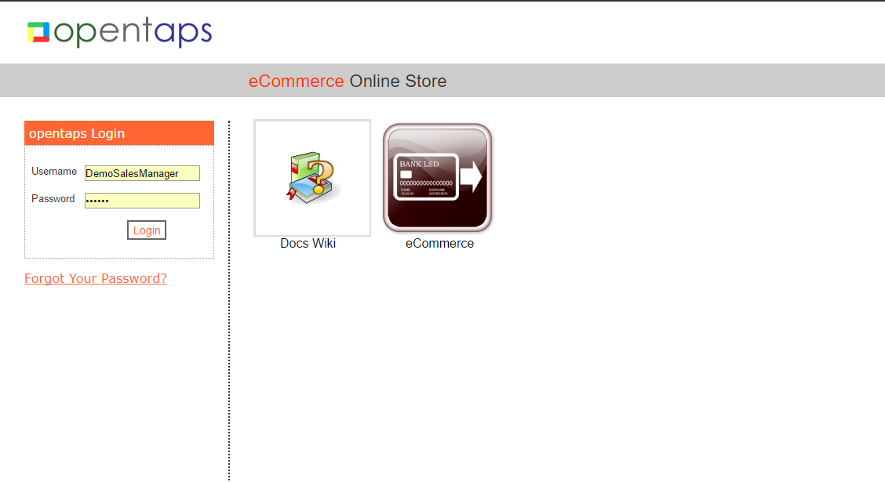
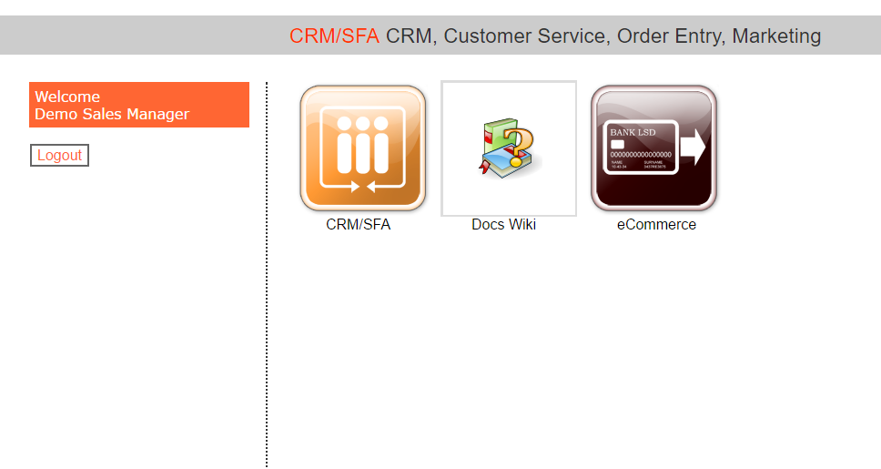
Pages

Slide 16
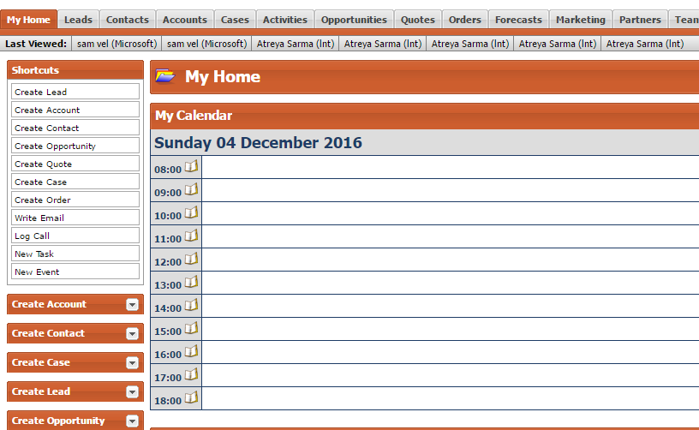
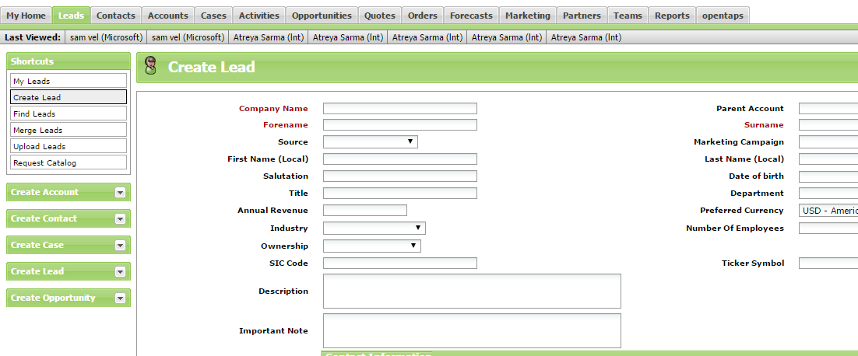
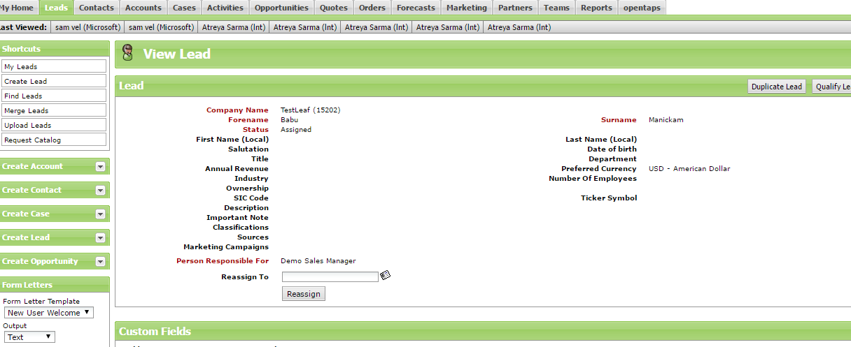
Pages

Slide 17
Login
Home
My Home
My Leads
Create Lead
View Lead
User Name
CRM / SFA
Leads
Create Lead
First Name
First Name
Password
Logout
Find Leads
Last Name
Login
Merge Leads
Company Name
Create Lead

Slide 18



Login
Home
My Home
My Leads
Create Lead
View Lead
User Name
CRM / SFA
Leads
Create Lead
First Name
First Name
Password
Logout
Find Leads
Last Name
Login
Merge Leads
Company Name
Create Lead

Slide 19

Login
Home
My Home
My Leads
Create Lead
View Lead
User Name
CRM / SFA
Leads
Create Lead
First Name
First Name
Password
Logout
Find Leads
Last Name
Login
Merge Leads
Company Name
Create Lead

Slide 20
Login
Home
My Home
My Leads
Create Lead
View Lead
Find Leads
Update Lead

Slide 21
Login
Home
My Home
My Leads
Create Lead
View Lead
Find Leads
Update Lead

Slide 22
CONTACT US

Slide 23
KEEP IN TOUCH WITH US
WE ARE HERE TO ASSIST YOU
Address
22, First Floor, College Road, Nanganallur
Chennai, India , 600061
Contact Info
Email: sakthivel@testleaf.com
Information: info@testleaf.com
Support: contact@testleaf.com
Telephone
Office Phone: +91 (44) 4554 4246
Sales: +91 (950) 000 6373
Support: +91 (984) 057 7905

Slide 24
THANKS FOR
LISTENING

